Slide 1

Analysis of Bank Customer Churn

Slide 2

Table of Contents
01
02
03
04
05
Background & Problem
Data Preparation
Exploratory Data Analysis
Conclusion
Thank You

Slide 3



01. Background
As the banking industry faces increasing competition and higher customer expectations, accurately analyzing customer churn has become a critical factor for banks in their efforts to retain customers and enhance overall customer satisfaction. Understanding the underlying factors that contribute to customer churn can provide valuable insights that help banks develop targeted retention strategies, optimize the customer experience, and improve overall customer relationship management practices. By leveraging advanced analytics and data-driven approaches, banks can gain a deeper understanding of customer behavior and preferences, enabling them to address customer churn more effectively.

Slide 4

01. Problem Statement
You are an analytical CRM (Customer Relationship Management) specialist hired by a bank to extract meaningful insights from various customer-related datasets.
The bank aims to reduce customer churn, improve service delivery, and enhance customer satisfaction.
They have provided you with datasets including customer demographics, transaction details, customer exit information, and active customer profiles.

Slide 5
02. Data Preparation
Checking Duplicate Value
Checking Missing Value
Feature Grouping
Conversion
Checking for data duplication. The result is that there are no duplicate data
There are no missing values in this data.
Extracting customer type features, and transforming the data into the desired form.
Converting categorical data into numerical. The encoding in this case is ordinal encoding.

Slide 6

03. Exploratory Data Analysis
Analysis
Bivariate Analysis
Correlation
Exploratory Data Analysis (EDA) is useful for understanding data deeply and gaining valuable knowledge through data visualization. The EDA in this project consists of univariate, bivariate, and correlation analyses.

Slide 7
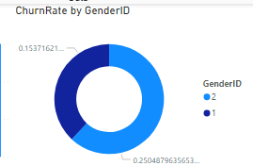
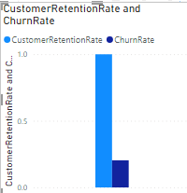

03. Analysis
The graph above shows the distribution of the target variable, it is known that the number of Churn bank customer is 20%. It is concluded that there is an imbalance in the data on the target variable.
The graph above shows the distribution of the target variable by 'Gender'. Male bank customers churn the most with a percentage of 25.04% compared to Females who have a percentage of 15.37%.

Slide 8
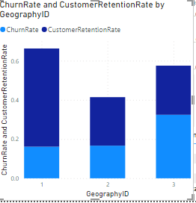
03. Analysis
The graph shows the distribution of target variables by 'Geography'.
Spain and Germany have a retention percentage of 25% each and Spain with a France percentage of 50%.

Slide 9
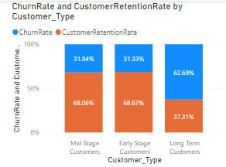
03. Analysis
The above graph shows the distribution of customer type based on churn status. Customers who are mid stage and are I early stage have relative similar churn rate and retention rate, and as far as Long term customers are concerned they have chosen to leave the bank as their churn rate is higher.

Slide 10
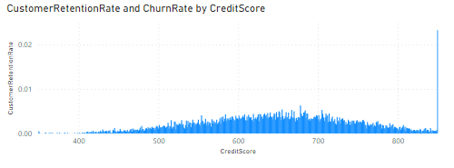
03. Analysis
The chart above shows the distribution of 'CreditScore' by churn status. The credit score distribution of churn and retain customers is similar, spread between 600 and 700.

Slide 11
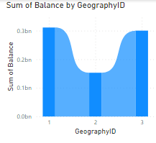
03. Analysis
The graph above shows the distribution of 'Balance' based on Geography. The balance distribution of customers is similar for France and Germany. And it is lowest for the Spain.

Slide 12

04. Conclusion
Business Insights
Male bank customers churn the most with a percentage of 25 % compared to Females who have a percentage of 15 %.
Customers who are mid stage and are I early stage have relative similar churn rate and retention rate, and as far as Long term customers are concerned they have chosen to leave the bank as their churn rate is higher.
France and Spain have a churn percentage of 16 % and 17 % and Germany with a churn percentage of 32%.

Slide 13


Thank You
by Rucha

